Slide 1
JQuery
Anil Rautela

Slide 2
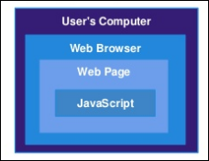
What is scripting language?
Can’t Communicate with OS.
Can’t Access local files.
Can’t directly access database.
Can’t access Hardware.
Client Side language.
Works on DOM.

Slide 3
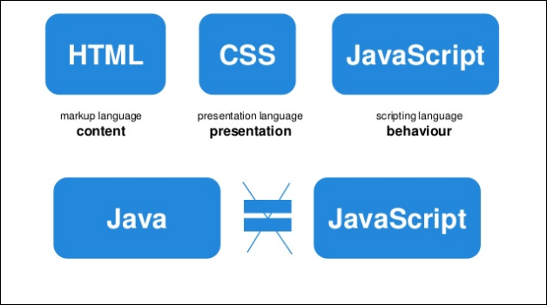
Introduction to JavaScript.

Slide 4
What is Jquery?
jQuery is a fast and concise JavaScript Library that simplifies HTML document traversing, event handling, animating, and Ajax interactions for rapid web development.
jQuery is an Open-Source JavaScript framework that simplifies cross-browser client side scripting.
Animations
DOM manipulation
AJAX
jQuery was created by John Resig and released 01/06.

Slide 5
What is DOM?
Long story short, the DOM is your html document code. From the <!DOCTYPE> to the </html>
The DOM is loaded top to bottom, so include your scripts at the bottom of the page for best performance.
The DOM is "ready" when everything on the page has loaded.
Stylesheets
JavaScripts
Images

Slide 6
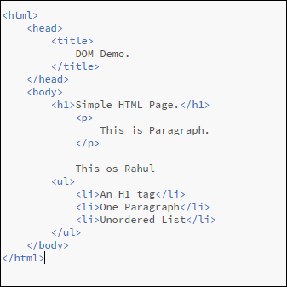
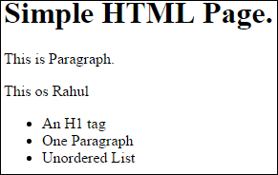
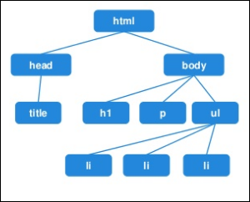
DOM Continues..

Slide 7
Aspects of DOM & Jquery.
Identification: how do I obtain a reference to the node that I want.
Traversal: how do I move around the DOM tree.
Node Manipulation: how do I get or set aspects of a DOM node.
Tree Manipulation: how do I change the structure of the page.

Slide 8
Why Should we use JavaScript?
Open Source : jQuery is developed by and available in the Open source community, thus it is free to use (like most programming languages).
Endless Tutorials: There are a ton of tutorials to help any novice developer to design a web page.
Huge Library : From simple items like image slider, display audio/videos… the resources are endless.
Cross-platform : jQuery is great at handling all cross-browser issues.
SEO : The larger benefit of jQuery is that the files are very small and can be easily optimized for site speed.

Slide 9
Who Uses jQuery?
Google
Amazon
IBM
Microsoft
Twitter
Dell

Slide 10
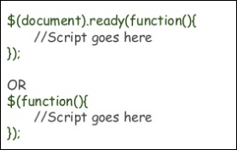
How to Enable Jquery in your page.
Jquery can be enable in your page by including reference to Jquery library file.
Introduce a Jquery function by using the below given function :

Slide 11
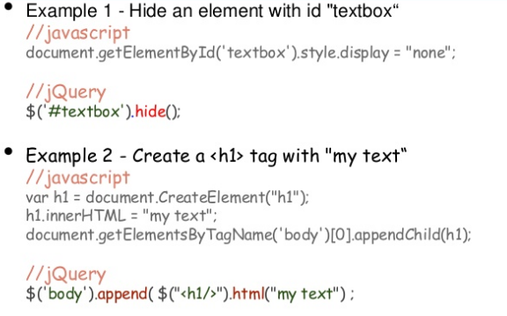
JavaScript V/s Jquery

Slide 12
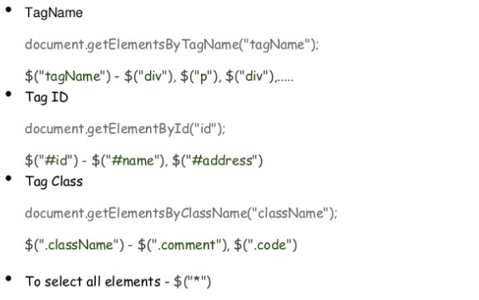
Basic Selectors in Jquery.

Slide 13
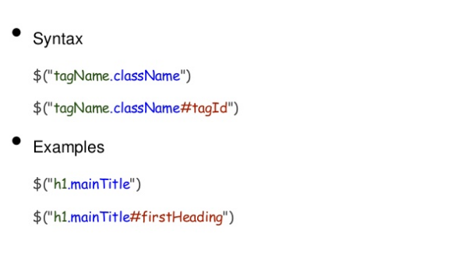
Combined Selectors in Jquery.

Slide 14
Basics Methods of Jquery.
.show()
.wrap("<a></a>")
.parent("p")
.html()
Show a hidden element
wrap an element with <a>
Select parent <p>
Get/Set innerHTML
.val()
Get/Set Value

Slide 15
JQuery Events
bind()
unbind()
ready()
toggle()
hover()
trigger()

Slide 16
JQuery Animation Events
show()
hide()
fadeIn()
fadeOut()
slideUp()
slideDown()

Slide 17
JQuery Additional Features
JQueryUI
AJAX (Asynchronous JavaScript and XML)

Slide 18
Thank You

